Slide 1


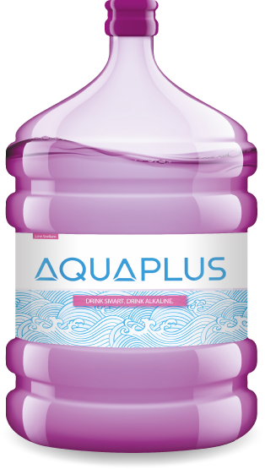
CORPORATE PROFILE

Slide 2

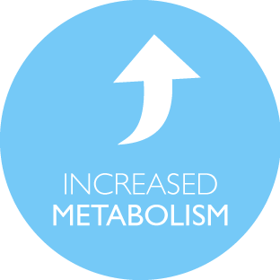
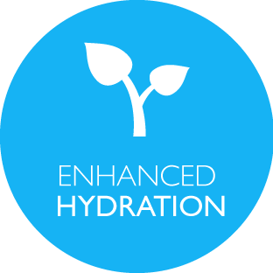
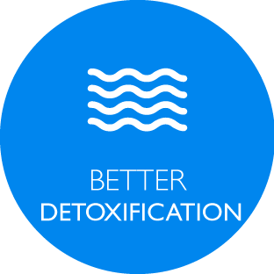
A HEALTHY FUTURE FOR ALL
AQUAPLUS is a focused water company that aims to make a difference in the UAE. We provide refreshing water that is put through a Unique Filtration Process, which gives it rejuvenating alkaline, antioxidant and ultra-hydrating properties.

Slide 3



VISION, MISSION AND CORE VALUES
Our Vision is to be the leader in the international health water industry by creating and delivering beneficial products that exceed customer expectations while ensuring a balanced and caring culture.
At AQUAPLUS, we are committed to improving the quality of life of the communities we serve. We do this by striving for leadership and global competitiveness in the business.

Slide 4
WHY AQUAPLUS?
Packaged in BPA Free Bottles
High Tech Cleaning and Sterilization Cycle
Only Company in the region to use BPA Free Bottles.
Completely Customized process to ensure safe energizing water at your door step.
ALKALINE
QUALITY CONTROL
AUTOMATION
BPA FREE
ENERGIZED
Unique Filtration Process
Rigorous Quality Control
Automated CRM
This makes the water ALKALINE.
.

Slide 5
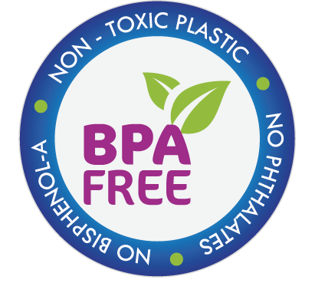
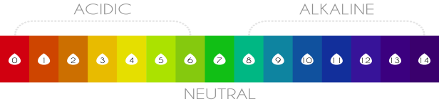
WHAT IS BPA FREE PACKAGING
AND ALKALINE WATER?
Bisphenol A (BPA) is an industrial chemical that is used in making plastic products, and research has shown that this substance can seep into food and beverages stored in containers that are made with BPA. Exposure to BPA can be a major concern, as it can have serious adverse health effects on people who consume these products. The material used to make the 5 gallon bottles at Aquaplus is the same that is used to make baby bottles.
The “alkaline” in alkaline water refers to its pH level. The Ph level is a number that measures how acidic or alkaline a substance is on a scale of 0 to 14. For example, something with a pH of 1 would be very acidic and something with a pH fo 13 would be very alkaline. Alkaline water is with a pH value greater than 7.
Human bodies should maintain a pH level of 7.35 to 7.45.

Slide 6




BENEFITS OF AQUAPLUS ALKALINE WATER
Neutralizes acidity caused by diet, stress and pollution
More energy by improving blood oxygen levels
Restores body function by cleaning your cells from the inside out.
Prevents diseases such as arthritis cancer, hypertension, diabetes, digestive and weight problems, Altham skin allergies and Acid reflux.
Improves Immune System
Weight Loss

Slide 7
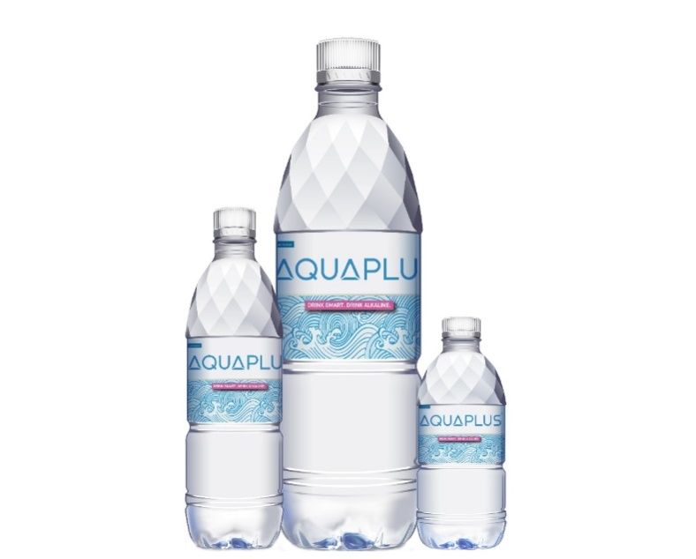
PRODUCT OFFERING AND PRICING
    5 Gallon water packed in special BPA free bottles come is 3 variants
    Aed 100 for 10 coupons (Aed 10/bottle)
    Aed 200 for 24 coupons (Aed 8.33/bottle)
    Aed 350 for 44 coupons (Aed 7.95/bottle)
    330 ml X 12 bottle pack for AED 8 per pack
    500 ml X 12 bottle pack for AED 8 per pack
    1.5 L X 6 bottle pack for AED 8 per pack
    Hot/Cold Dispenser - AED 335
    Counter top Dispenser - AED 35
5 Gallon BPA Free Bottle
500ml 1.5L 330ml

Slide 8
TESTIMONIALS
“Great water and amazing turn around time for delivery!”
“Great Service and an excellent logistics team.”
“Alkaline water is the way to go!”

Slide 9




















CLIENT PORTFOLIO

Slide 10

CERTIFICATIONS
AQUAPLUS is certified by ESMA along with ISO 22000 and HACCP certification by SGS Gulf.

Slide 11






AQUAPLUS – YOUR PREFERRED CHOICE
Alkaline Water
BPA Free Water
Dedicated Call Center Team
Fully Automated CRM
95% Customer Satisfaction
10,000+ Customers

Slide 12
THANK YOU

